Slide 1
How does a neuron produce a signal?

Slide 2
In circuits,
current is carried by electrons.
In neurons (and muscle cells),
positive and negative ions
carry current.

Slide 3
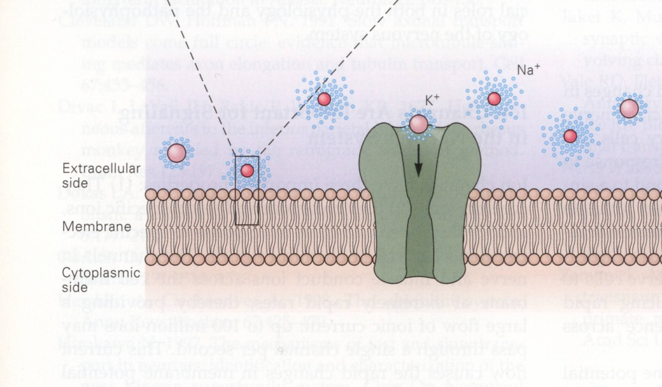
Ion channels are proteins that span the cell membrane
Notes:
Ion channels are found in all cells of the body.
Different channels for different ions. Ion channels are very selective.
Different cells of the body have different proportions of ion channels of different types, and have different signaling properties.
The ion channels of nerve cells are special—they are tuned for information processing.
Ion channels are the site of action of drugs, poisons and toxins. If ion channels malfunction, various neurological diseases can occur.

Slide 4
Ion channels have three
important properties
1. Conduct ions.
2. Recognize and select specific ions.
3. Open and close in response to specific electrical, mechanical or chemical signals.
Notes:
1. Upto 100 million ions may pass through a single channel per second→
Cause rapid change in membrane potential (V_{m}).
2. K⁺ channels are 100 times more permeable to K⁺ than Na⁺.
Na⁺ channels are 20 times more permeable to Na⁺ than K⁺.
3. Ion channels are gated.
Voltage-gated, ligand-gated, mechanically gated (pressure or stretch).

Slide 5
Why do nerve cells have channels?
Membrane is composed of lipids and proteins.
Lipids are hydrophobic. Ions are hydrophilic.
Unlikely for ion to move from solution into lipid bilayer. Hence, lipid bilayer impermeable to ions.
Ion channels allow ions to flow through without stripping them of their waters of hydration.
Notes:
With ion channels, conductance of membrane is about 40,000 higher than without.
Ions attract water. Surrounded by waters of hydration.
For an ion to move away from water into the non-charged hydrocarbon tails of the lipid bilayer takes a lot of energy.
Ion channels are the solution around this energy problem.

Slide 6
Why do nerve cells have channels?
The flux of ions through channels is passive i.e.
no expenditure of energy by the ion channel
Measure channel’s conductance (g = 1/R), which is current that flows in response to a given electrochemical force.

Slide 7
What makes channels selective?
Not only ion diameter (size varies inversely with mobility): need to explain Na⁺ and K⁺ selective ion channels.
Channels have narrow regions that act as molecular sieves. At the selectivity filter, ion sheds its waters of hydration, forms weak chemical bonds with charged amino acid residues.
Ion stays bound in channel for 1 μs (weak binding). Allows for high conduction rates.
Energy released during process allows ion to traverse and compensate for loss of waters of hydration.
Variable electric field strength of binding site imparts variable selectivity (low favors K+, high favors Na+).

Slide 8
What makes channels selective?
Pore diameter, molecular sieving
Specific chemical interactions with selectivity filter

Slide 9
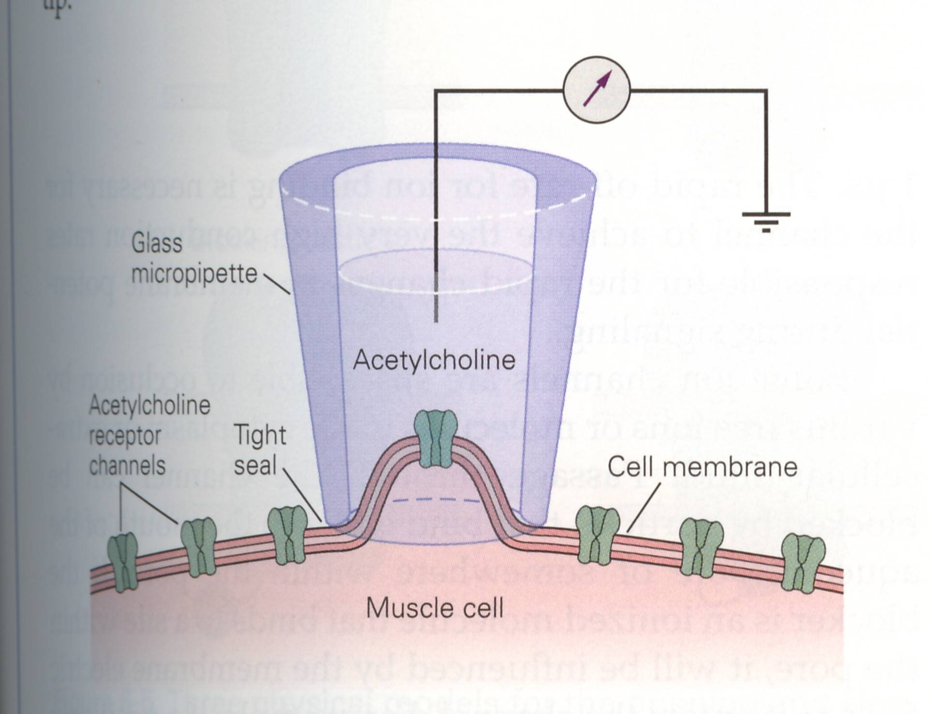
How to record from single ion channels
Patch-clamp
technique
Notes:
Neher and Sakmann (1976).
Cell treated with proteolytic enzymes (later in-vivo nerve cell experiments did not use this application) to remove connective tissue from cell surface
A small fire-polished glass micropipette with a tip dia. of 1 μm is pressed against the membrane of the cell.
Pipette filled with ECF-like contents (later experiments used drugs for specific purposes).
A metal wire in the pipette measures current in the channels under the pipette tip.
Apply a small amount of suction forms a tight seal between membrane and pipette. This results in a seal with a very resistance between the inside and outside of the pipette—isolate whatever is inside the pipette from whatever is outside. This seal lowered electronic noise, making it possible to record from all kinds of channels, including channels with small conductances.
Apply a lit bit more suction later, and the seal breaks, and then you can affect the contents of the cell with drugs, chemicals etc. You now have an intracellular recording.

Slide 10
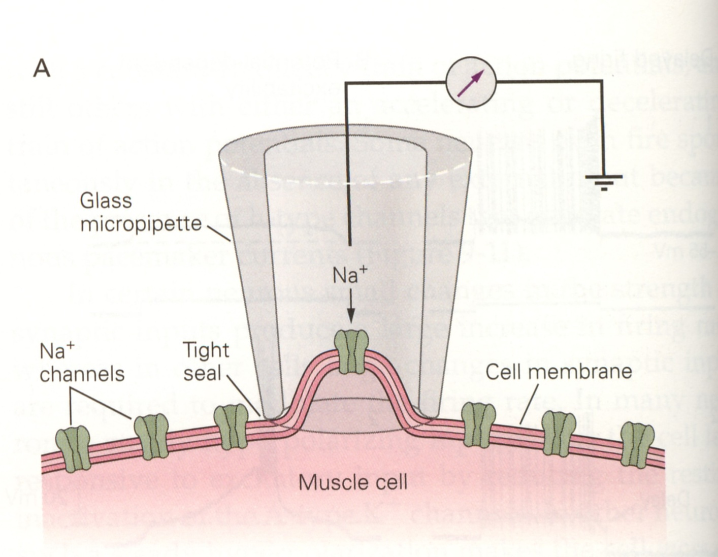
A single Na⁺ channel isolated
using the patch-clamp technique

Slide 11
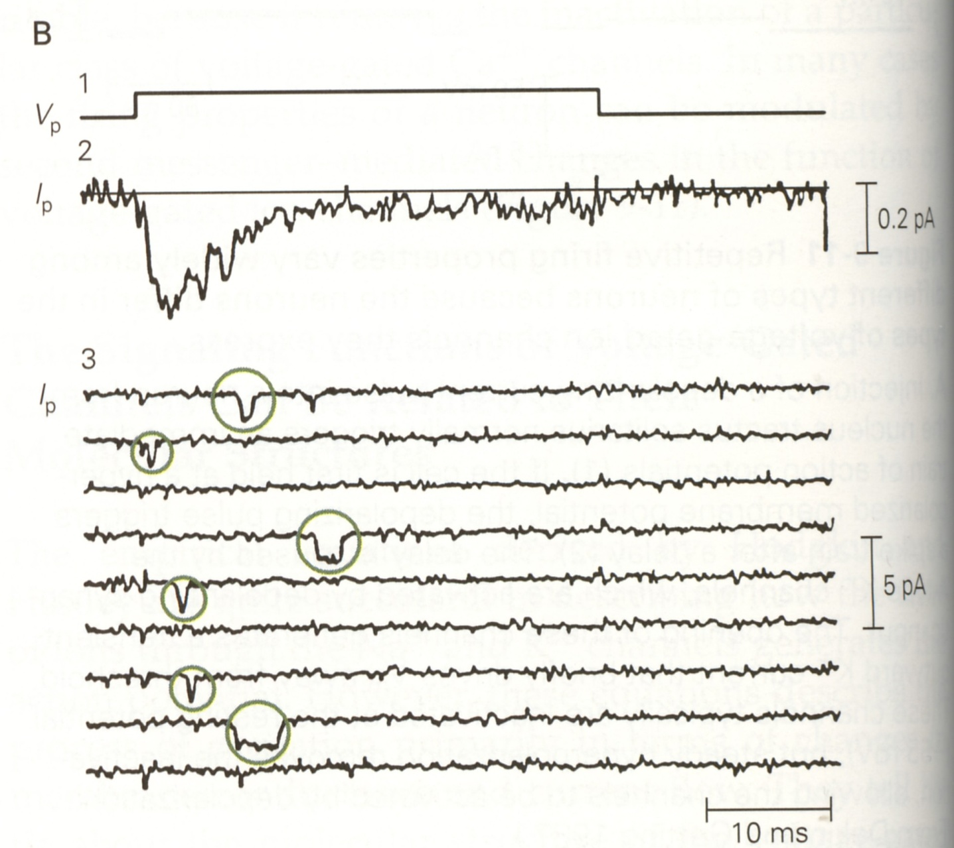
All or none opening of the Na⁺ channel
Notes:
Recordings of a single Na+ channel in cultured muscle cells of rats in response to a +10 mV voltage step applied across the membrane patch.
Each circle represents an opening. Note the amplitude of the current (in pA) remains the same across all six circles, although the duration varies.
The figure consists of a time sum of multiple opening events of the same channel, and the V→I plot at the top is the sum of these individual channel openings. A recording of the cell’s Na channels (the total Na current or I_{Na}) during a single depolarizing event is likely to exhibit a similar curve as shown here, which would indicate that the process of channel opening, a stochastic or random process, is ergodic. A schematic figure of I_{Na} is shown in the next slide.

Slide 12
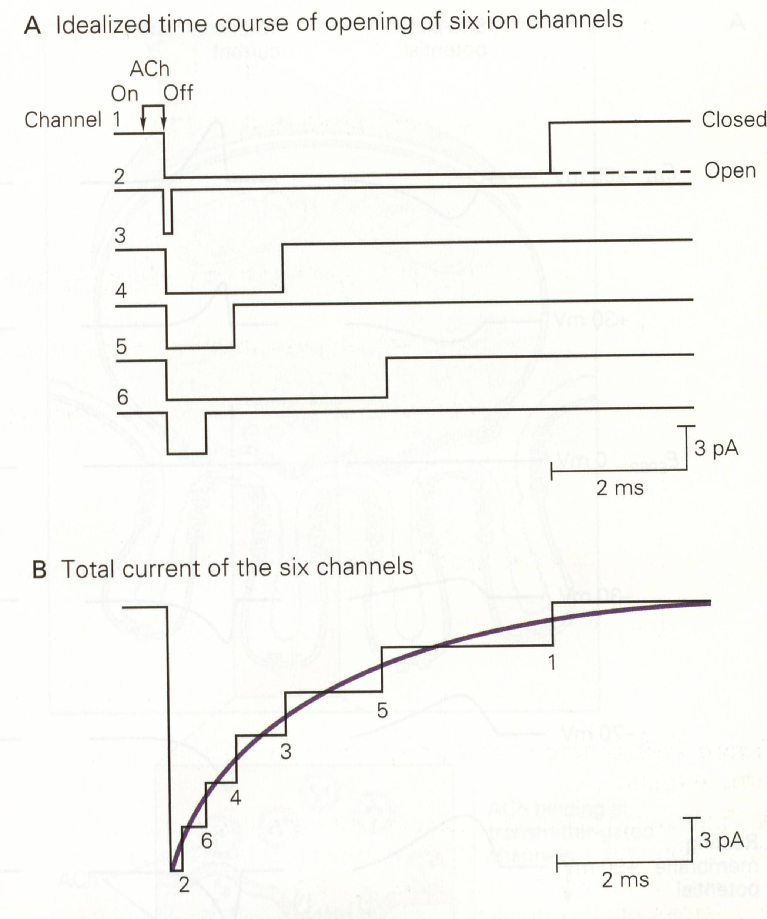
All or none opening of the Na⁺ channel
Notes:
A current is the sum of the currents of all the ion channels (that are open at that time).

Slide 13
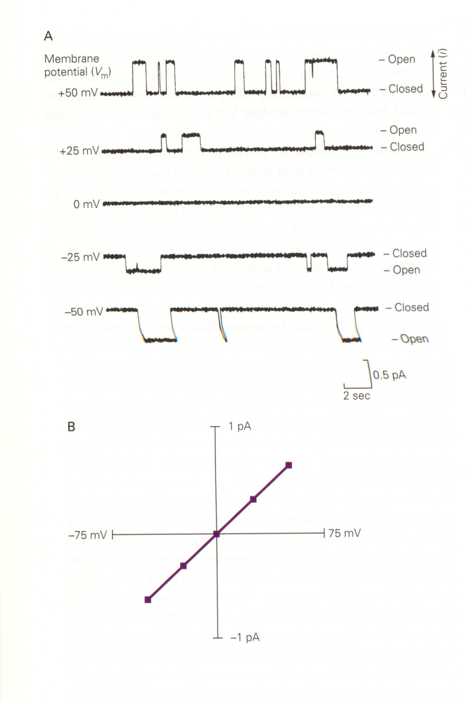
Properties of ion channels
Open and close in
all-or-none fashion
A channel is an
electrical resistor
Notes:
Current linearly related to voltage in some channels. At high concentrations of the ion in solution, the current does not increase with concentration but saturates.
The fact that current does not increase with ion concentration for high ion concentrations is consistent with the idea that ions do not diffuse, do not follow the laws of electrochemical diffusion, but rather bind with specific polar sites in the channel (once concentration gets too high, all ion channels occupied, no more channels left for ion to go through).
Not only that….

Slide 14
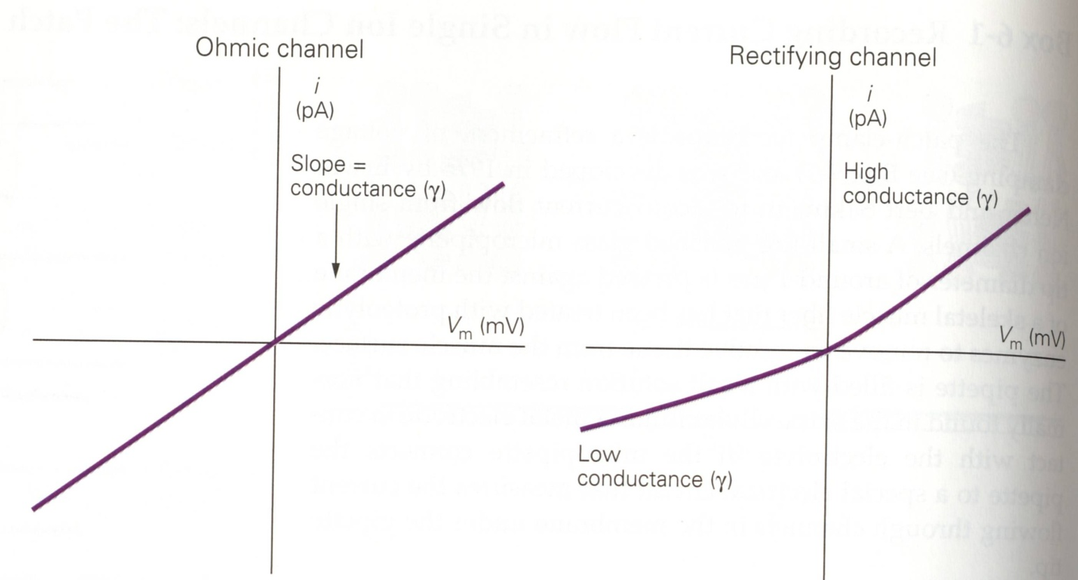
Properties of ion channels
Notes:
Ion channels are not ohmic but rectifying.

Slide 15
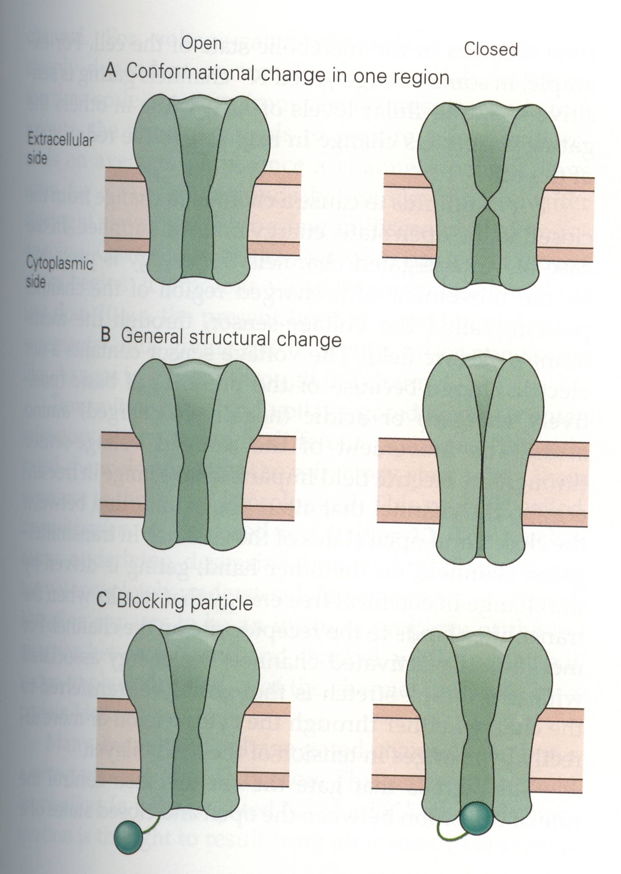
Properties of ion channels
Notes:
Three physical models of the opening and closing of channels
Localized conformational change in one region of the channel.
2. A generalized structural change along the length of the channel.
3. A blocking particle swings into and out of the channel mouth (ball and chain model).

Slide 16
Properties of ion channels
Ion channels can exist in one of three states:
1. Open
2. Closed (Resting)
3. Refractory (Inactivated)
Mechanisms for 2 and 3 are separate

Slide 17
Properties of ion channels
Open →Refractory →Closed

Slide 18
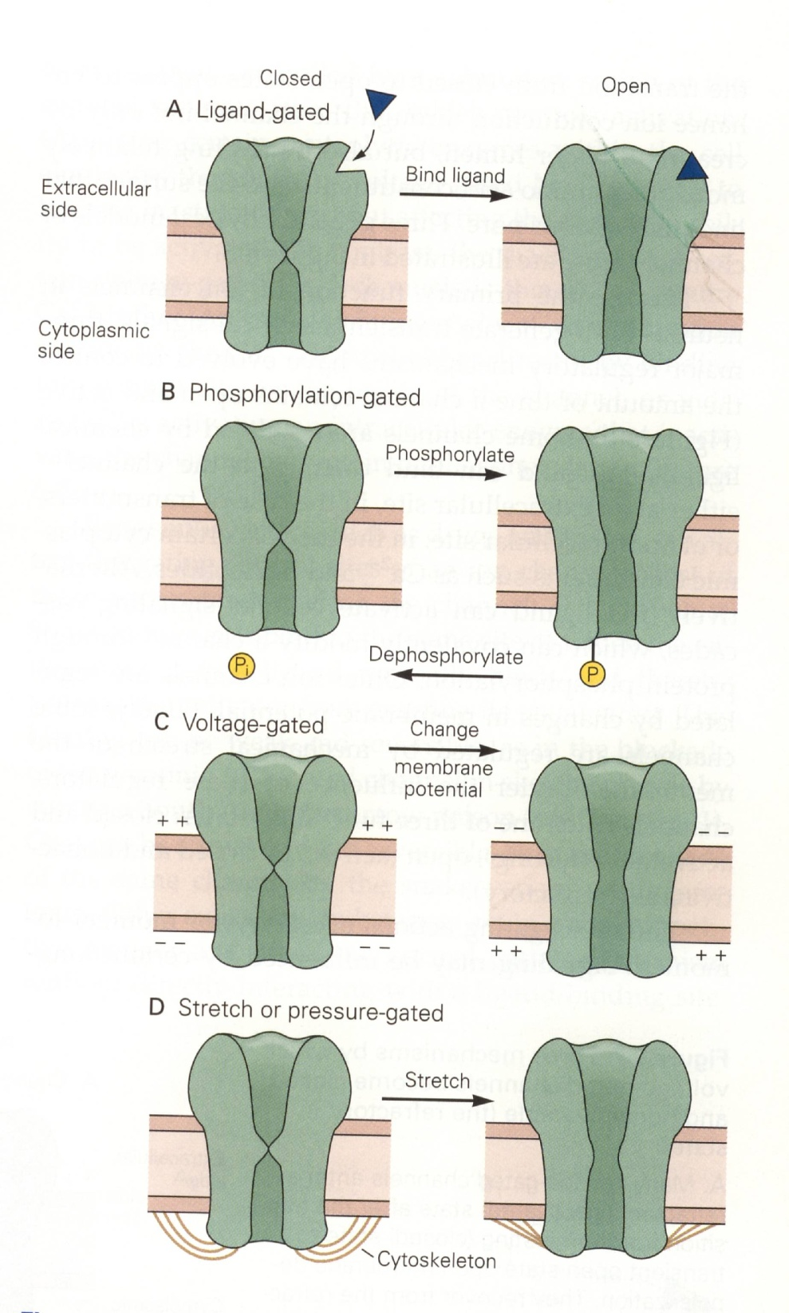
Stimuli that control opening, closing of channels
Notes:
Channel-opening is an energetic process (ions going through channel is not an energetic process). Where does the energy come from?
A. Ligand-gated channels open when the ligand binds to its receptor. Energy released when ligand bound. Drives the channel toward an open state.
B. Protein phosphorylation (adding a PO3⁻ group) and dephosphorylation. Energy for channel opening comes from the transfer of the high-energy phosphate P_{i}.
C. Changes in membrane voltage. Energy comes from a change in electrical potential difference across the membrane, which acts on a component of the channel having a net charge, thus causing a conformational change in the channel.
D. Energy for channel opening comes from mechanical forces that are passed to the channel through the cytoskeleton.

Slide 19
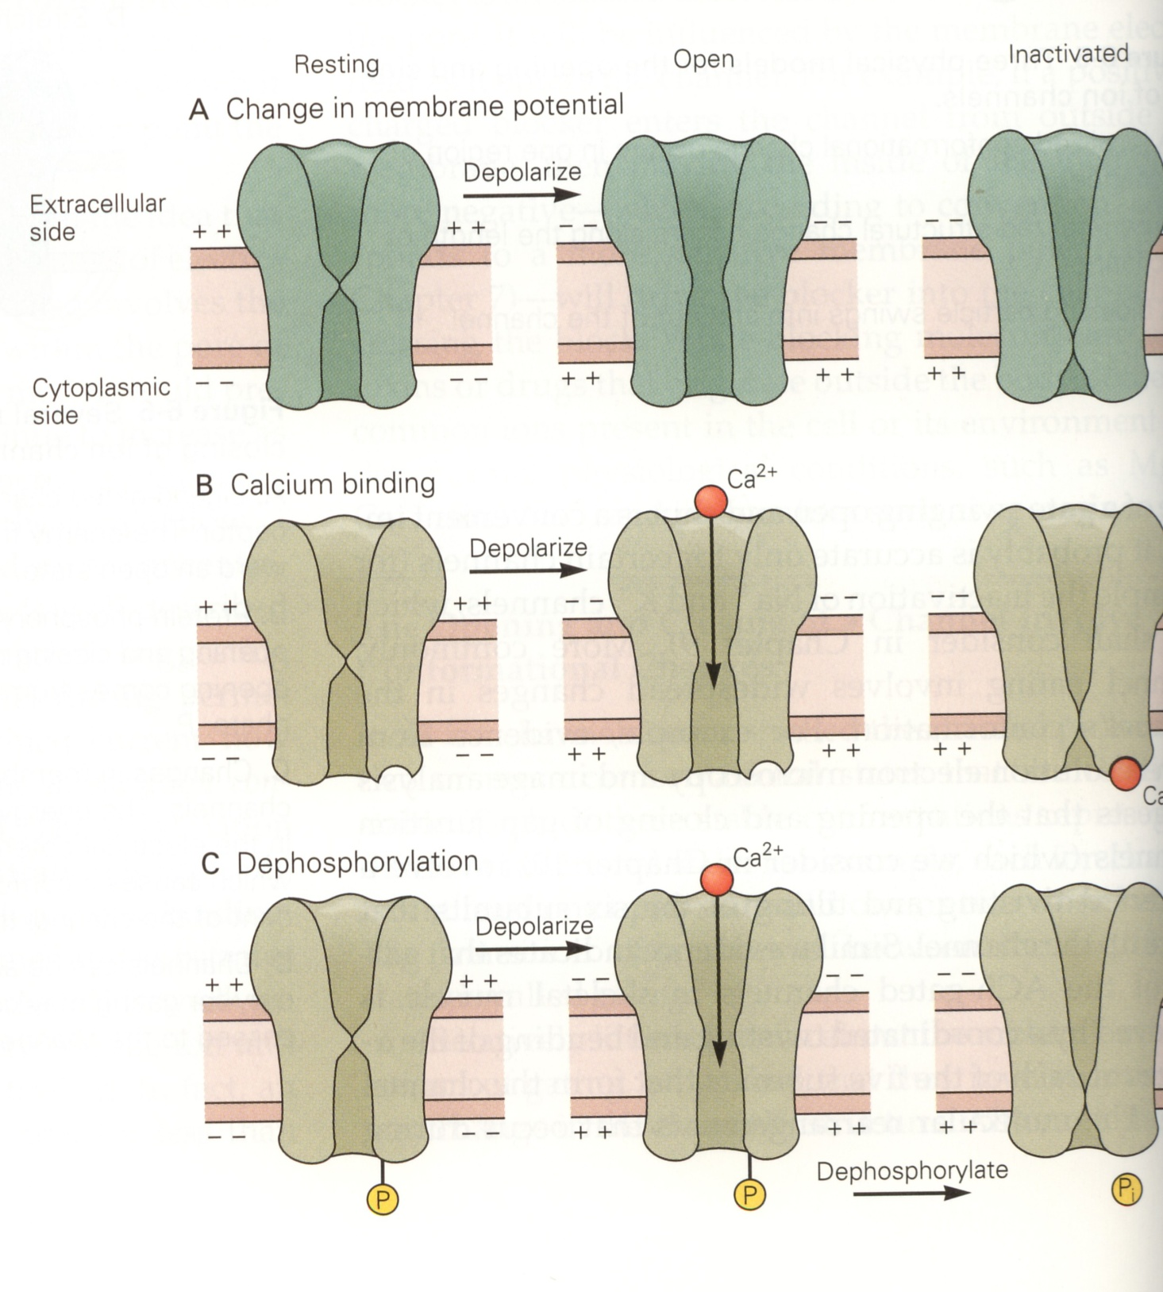
Mechanisms by which channels become refractory

Slide 20
Review
_________ carries current in muscle cells, neurons
Why do nerve cells have ion channels?
What are ion channels?
Properties of ion channels
What makes ion channels selective?
How can we find conductance of a channel?
Relationship between ion channels and lipid bilayer
Ion channels open and close in an ___________ fashion
Mechanisms for opening, closing channels
Mechanisms by which channels become refractory
Patch clamp technique, uses

